Slide 1
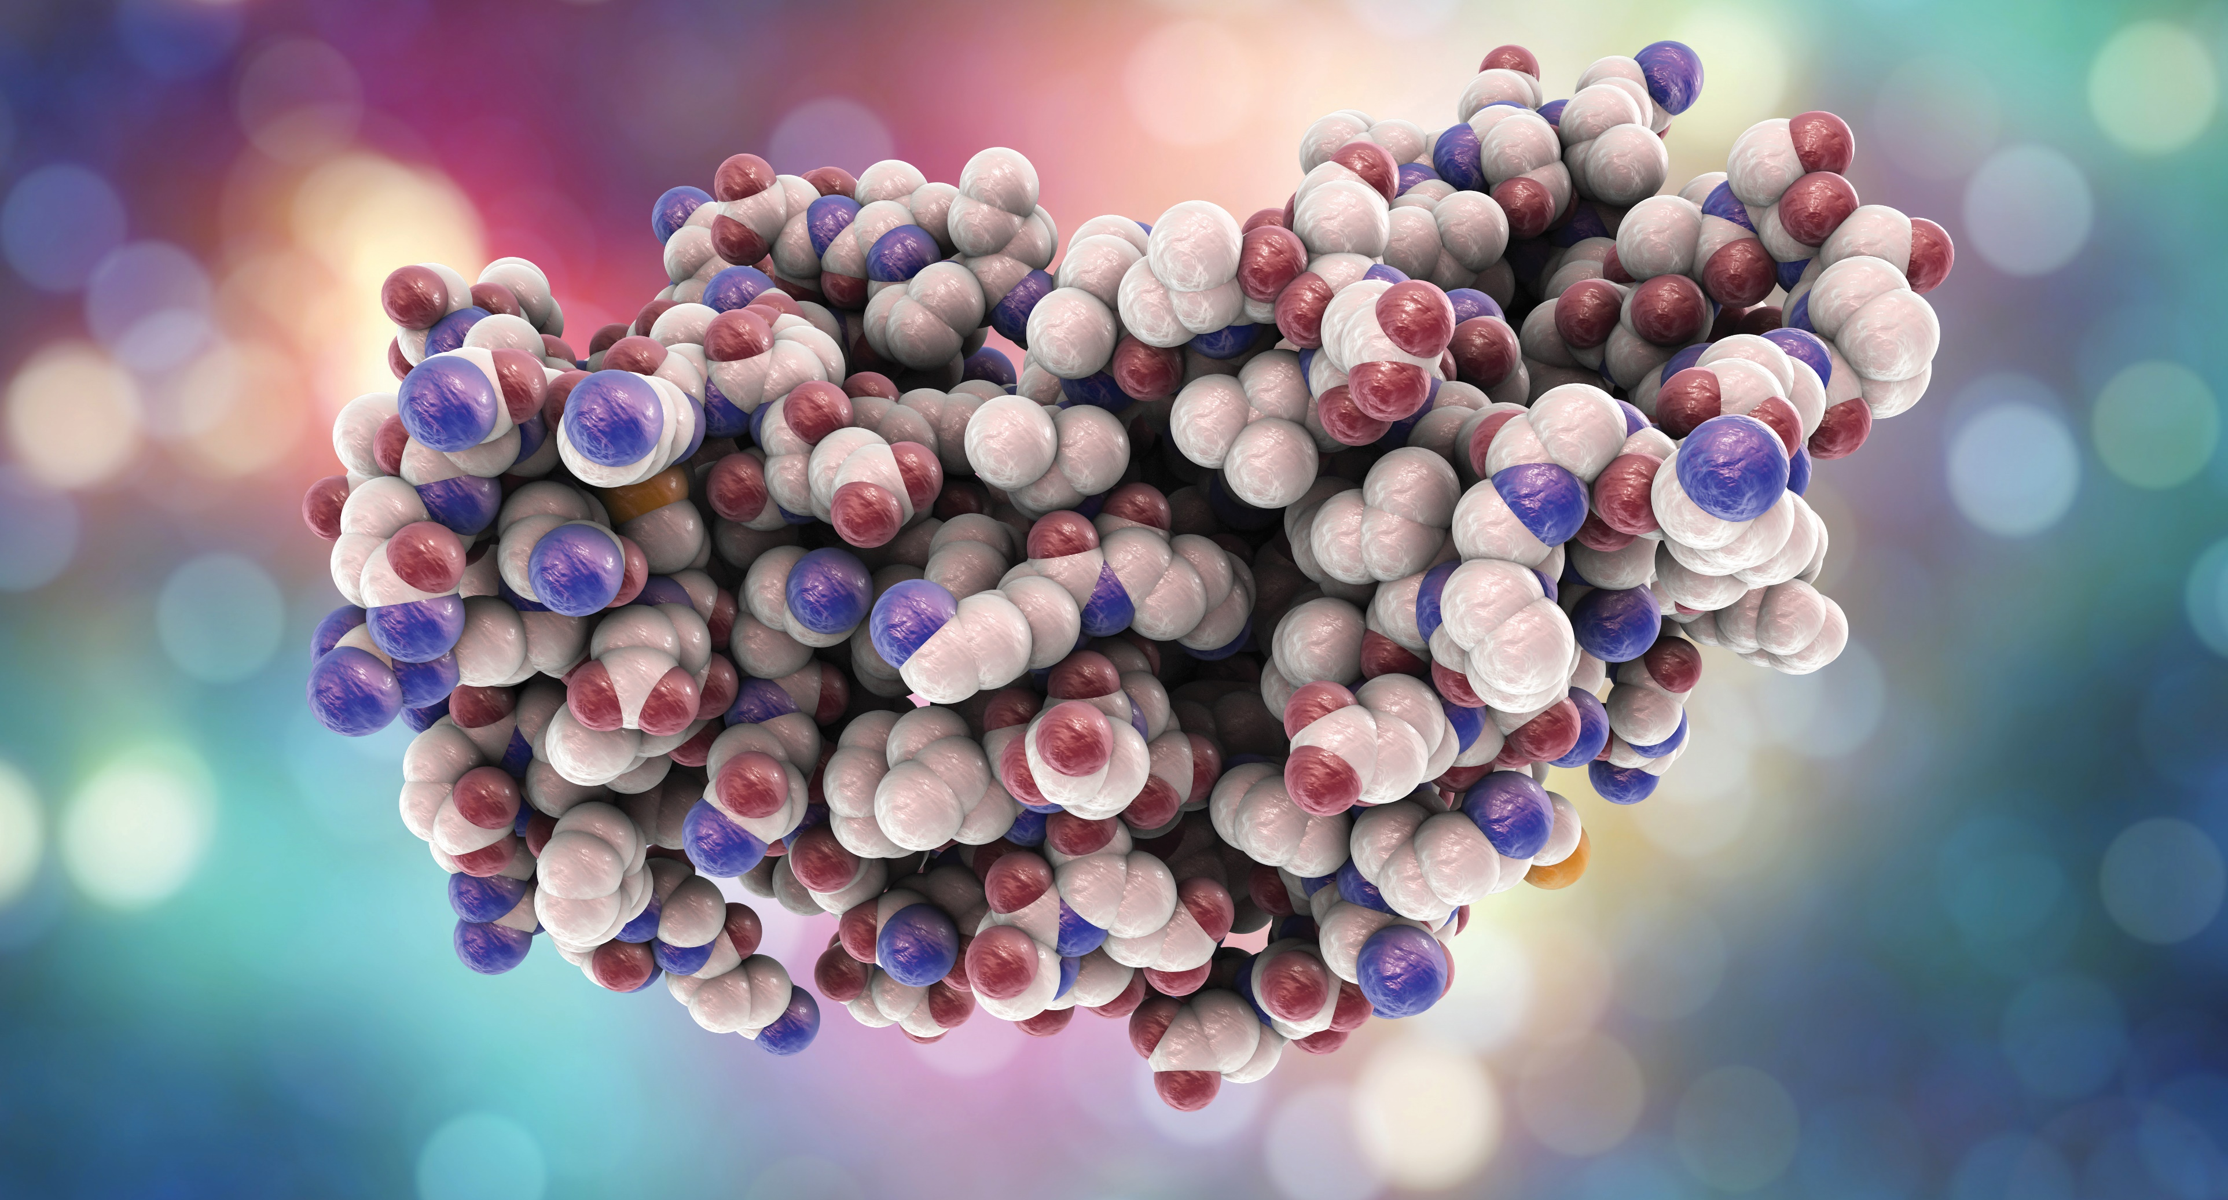
PROTEOMICS with PROFESSOR NEIL KELLEHER
Molecular model of interferon-gamma 3D illustration. IFN-gamma is a protein produced by leukocytes and involved in innate immune response against viral infections. By Kateryna_Kon

Slide 2
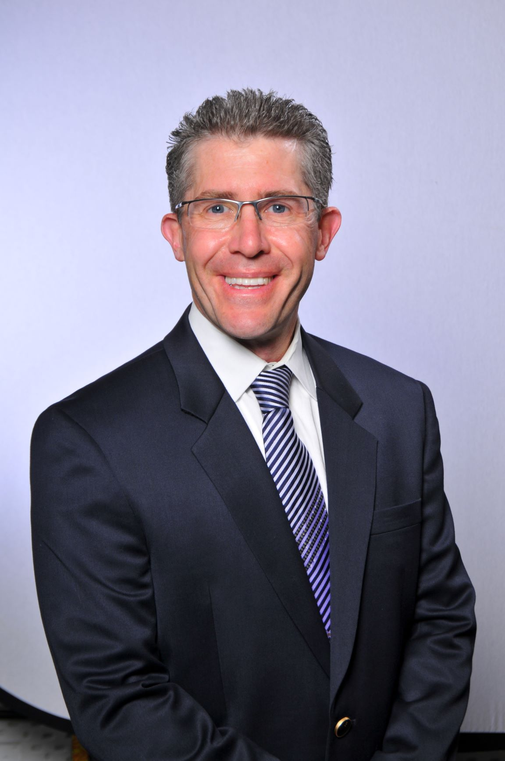
MEET NEIL
Professor Neil Kelleher, of Northwestern University in Illinois in the US, has his sights set on bringing about a major leap forward in our understanding of proteins, by cataloguing every single protein in the human body.
“The Human Proteoform Project will allow us to know ourselves, and to understand our underlying biology with unprecedented precision,” explains Neil.
Let’s learn more about his research…

Slide 3
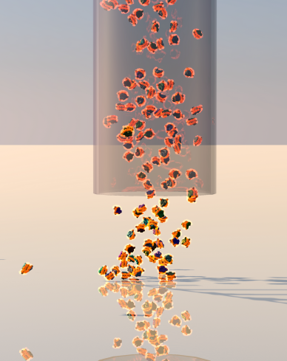
THE HUMAN PROTEOME PROJECT
Proteins:
have an endless array of possible shapes and structures
fulfil a huge diversity of functions
give the body structure
are integral to the functioning and replication of cells
are efficient at protecting us from disease.
Understanding how they work, therefore, can bring huge benefits for medicine and related fields.
The Human Genome Project mapped out the DNA sequence of every gene within the human body and was completed in 2003. Now, The Human Proteome Project will map out every protein in the human body.
Nuc-MS-spectrum-shadow

Slide 4
THE COMPLEX WORLD OF PROTEINS
The base sequence of a gene tells us the amino acid sequence of the protein that it codes for, but that is only the start of the story.
During and after the processes that create a protein from a gene, there can be any number of additional changes made to the protein. (For instance, certain conditions within the cell may lead to the addition of extra features such as carbohydrate groups, or even change the entire three-dimensional structure of the protein.)
This means that proteins with the same underlying amino acid sequence can have drastically different functions, which cannot be predicted from the gene alone. These differing varieties are known as proteoforms.
Neil estimates there are about one billion different proteoforms within the human body!
bird_3D_-_Pro_W

Slide 5
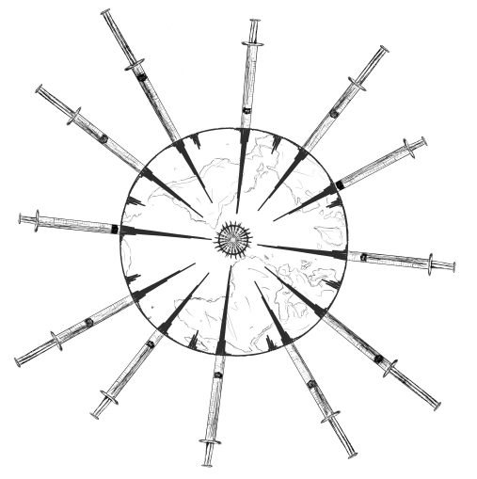
HOW IT WORKS
The first step for the project is to map out the body’s 4,000-odd different types of cell. These can be recognised and catalogued according to the unique array of proteins found on each cell surface. Categorising these is important because different conditions within each type of cell can lead to different proteoforms.
The second step involves cataloguing the proteins themselves. This will be achieved by finding their molecular weight – not just a simple weighing-scales measurement, but rather uncovering the identity of every atom within the protein molecule and how they fit together.
COVID_vaccine___RBD

Slide 6
TOP-DOWN PROTEOMICS
“Imagine a big pile of gold coins,” says Neil. “One of the coins is plastic and has a lighter mass to the others. How do you find it? Do you weigh every coin? Or do you split the pile in half and see which pile is lighter? If you keep splitting the pile like this, you will find the plastic coin faster – this is the ‘top down’ strategy.”
Top-down proteomics uses this logic to pinpoint and characterise individual proteoforms in a mixture.
(This technique differs from bottom-up proteomics, which involves digesting the proteins first and sorting through the resultant fragments. This cannot distinguish between proteoforms because the overall shape and structure of the protein has been lost.)
Microscopic nano disease-causing bacteria inside the human body. Nanotechnology in blood flow among cells hemoglobin. Innovation technology in medicine. Future concept. By fantastic

Slide 7
TALKING POINTS
What is the Human Proteome Project aiming to do?
Why can proteins with the same underlying amino acid sequence have different functions?
How many different proteoforms does Neil estimate are in the human body?
What is the ‘top-down’ approach to proteomics? (Read over Neil’s coin analogy to help you answers this.)

Slide 8
AN AMBITIOUS PROJECT
“This project is very ambitious, and poses a significant career risk for me,” says Neil. “It will be fantastic if it is completed, but if it does not generate sufficient enthusiasm within the scientific community, it could never materialise.”
In scale, it can be compared to the Human Genome Project. This became economically feasible when the mapping technology became efficient enough to map the genome at a cost of about $1 per DNA base.
Neil believes working on a similar economic model, with a cost of about $1 per proteoform, should mean that the project could be completed within ten to fifteen years.
“We have a worldwide consortium of 400 members, with increased funding coming in too,” says Neil. “This makes me hopeful that the Human Proteoform Project may come to pass within this decade, and not the next one!”
Nuc-MS-spectrum-shadow

Slide 9
CHANGING LIVES
A huge range of diseases, from cancer to heart disease, are caused by faulty proteins – in essence, bad proteoforms. By having an atlas of all these unwanted proteoforms, it will become dramatically easier to detect and combat disease.
“This project could accelerate our progress towards next-generation technology, leading to significant improvements in human health,” says Neil.
For instance, currently, the most common test for prostate cancer involves screening for a protein called prostate-specific antigen (PSA). However, PSA can exist as many different proteoforms, a number of which are not screened for, so it can commonly be missed. In the future, knowing exactly what these proteoforms are should make the screening test much more sophisticated and accurate.
bird_3D_-_Pro_W

Slide 10
The project could also help with developing cures.
Protein-based drugs function by detecting and attacking certain proteins – for instance, the proteoforms that exist on the surface of cancer cells. The more proteoforms that are known, the easier it becomes to develop highly specific treatments.
Despite massive advances in medicine in recent decades, a lot of detection and treatment methods are still very generalist.
For example, chemotherapy treatment does not just target cancer cells, and can take a severe toll on the rest of the body too. The Human Proteoform Project has the potential revolutionise medicine forever.
Neil’s vision reminds us that unwavering ambition and a willingness to take risks can lead people to great things.
COVID_vaccine___RBD

Slide 11
TALKING POINTS
If it will only cost $1 to catalogue each proteoform, why will this project still take many years to complete?
Why do you think the worldwide consortium that Neil refers to is important for the success of this project?
How will Neil’s project make it easier to detect disease?
How will it help the development of cures?

Slide 12
ABOUT PROTEOMICS
Proteomics is the large-scale study of proteins. It concerns the proteome, which is the name given to the entire set of proteins within an organism. Neil explains what it is like to research in this field.
WHAT DO YOU FIND MOST CHALLENGING ABOUT PROTEOMICS?
Unlike genomics, we cannot amplify the molecules that we study. This means we are often working with very tiny amounts of protein, which raises difficulties. This is a core challenge of proteomics, but proteins are massively important for biology, so we make it work.
WHAT HAVE BEEN SOME HIGHLIGHTS OF YOUR WORK IN PROTEOMICS?
Going public about the Human Proteoform Project was a major moment for me. Additionally, I get a lot of pleasure from discovering the precise traits of proteins in the human body. This is a ‘positive feedback loop’ that has sustained my dedication over decades, despite obstacles along the way.

Slide 13
WHAT TYPE OF PEOPLE DO YOU COLLABORATE WITH?
I collaborate with a very wide range of people. Doctors, clinician-scientists, biochemists, computer scientists, business leaders and research directors all take an interest in my work. Pooling our skills and networks is a fantastic way to make progress.
WHAT WILL BE THE BIGGEST FOCUS FOR THE NEXT GENERATION OF SCIENTISTS WITHIN PROTEOMICS?
Once all the proteoforms are mapped, the next big challenge is deciphering the exact function of each one and how they can be modified.
Nuc-MS-spectrum-shadow

Slide 14
EXPLORE A CAREER IN BIOSCIENCE
Disciplines such as biochemistry, molecular biology and biomedicine have the potential to lead to a career in proteomics.
Many universities offer public outreach schemes that help young people get a ‘taster’ of working in the lab. For instance, Northwestern University, where Neil works, sees many school students visit the campus and engage in summer research.
According to Payscale.com, the average salary for a molecular biologist is $59,000.
bird_3D_-_Pro_W

Slide 15
PATHWAY FROM SCHOOL TO BIOSCIENCE
Neil recommends taking subjects like chemistry and biology, and also computer programming and statistics.
Physics and areas of mathematics can also be useful.
Once at university, Neil recommends taking courses in cell biology, organic chemistry and genetics.
On the next slide, you’ll meet some of Neil’s colleagues who are also conducting important research in the field of proteomics.
What are they achieving and how would you feel joining them in their field?
COVID_vaccine___RBD

Slide 16
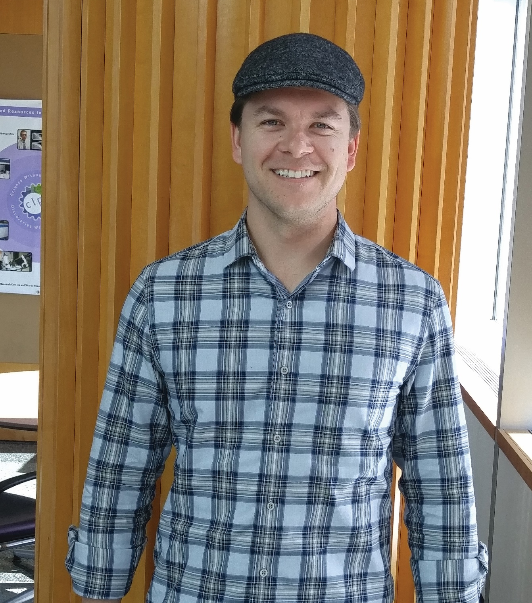
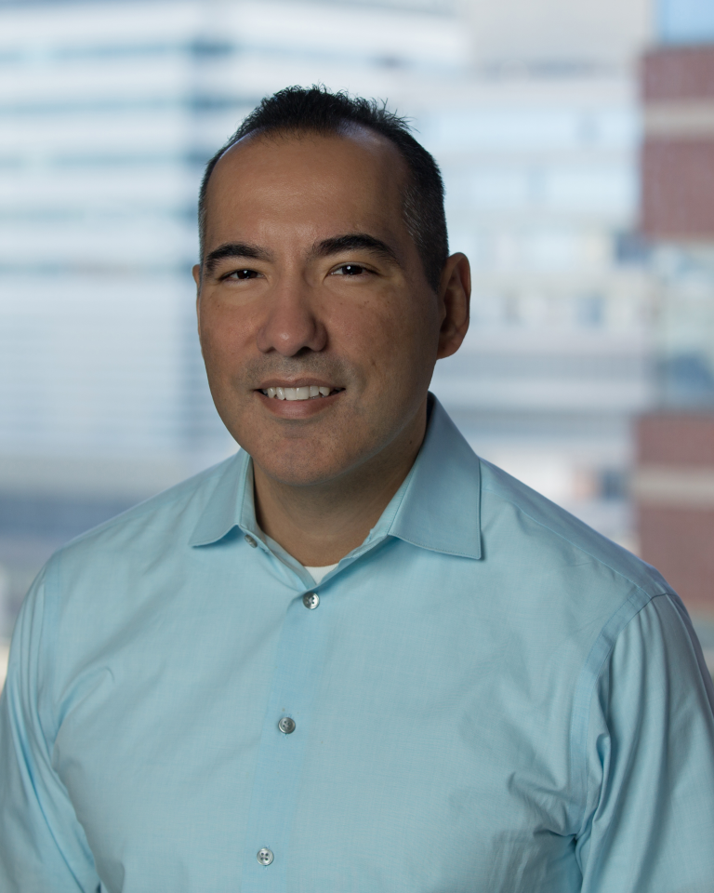
Jeannie Camarillo has been a researcher at the Kelleher Research Group for two years and is set to become a leader in the
proteomics field.
Phil Compton is a staff member with the Kelleher Research Group. His specialty is in construction and repair of the mass spectrometry devices used to perform top-down proteomics.
Dr Ben Garcia is Head of Biochemistry and Molecular Biophysics and leads the Garcia Lab at Washington University in St. Louis. Ben conducted postdoctoral research with Neil and now specialises in developing novel mass spectrometry methods.

Slide 17
TALKING POINTS
Why do you think going public with The Human Proteome Project is such a major step in Neil’s career?
Of the subjects Neil recommends, which do you particularly enjoy?
Which areas are you less familiar with? How could you find out more?
Where is your nearest university? Have you ever visited it? How could you find out more about any public outreach schemes it offers?

Slide 18
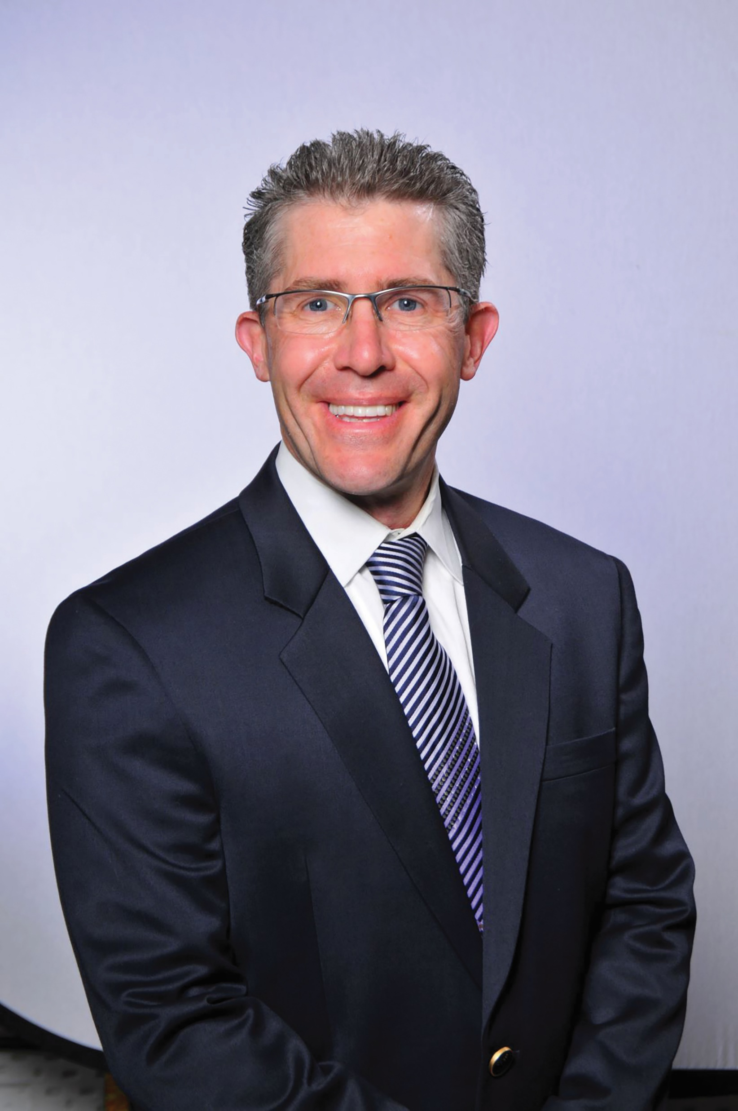
HOW DID NEIL BECOME A BIOSCIENTIST?
WHAT WERE YOUR INTERESTS AS A CHILD?
On the academic side, I enjoyed science and woodworking. I liked working with my hands, which helped lead me to a career in lab research. On the sports side, I enjoyed wrestling and golf, which helped me learn fortitude and mental toughness.
WHAT INSPIRED YOU TO BECOME A SCIENTIST?
At sixteen, I took an internship at the chemistry lab of the Weyerhaeuser paper company. It was there I learned that chemists have the solutions to real-world problems – and I even helped solve a small one myself!
WHAT ATTRIBUTES HAVE LED YOU TOWARDS SUCCESS?
Persistence, self-belief and an ability to embrace risk.

Slide 19
HOW DO YOU OVERCOME OBSTACLES IN YOUR WORK?
I find it useful to accelerate towards obstacles – I even revel in the struggle. That has helped me overcome substantial barriers and paved the way to success.
WHAT IS THE PROUDEST MOMENT OF YOUR CAREER?
I believe the highlight of my career is still to come! Having said that, the publications of some of my best research papers have been great moments. I also place great value on training the next generation of scientists.
HOW DO YOU SWITCH OFF FROM WORK?
I take pleasure in exercise, especially swimming, golf and jogging.
Microscopic nano disease-causing bacteria inside the human body. Nanotechnology in blood flow among cells hemoglobin. Innovation technology in medicine. Future concept. By fantastic

Slide 20
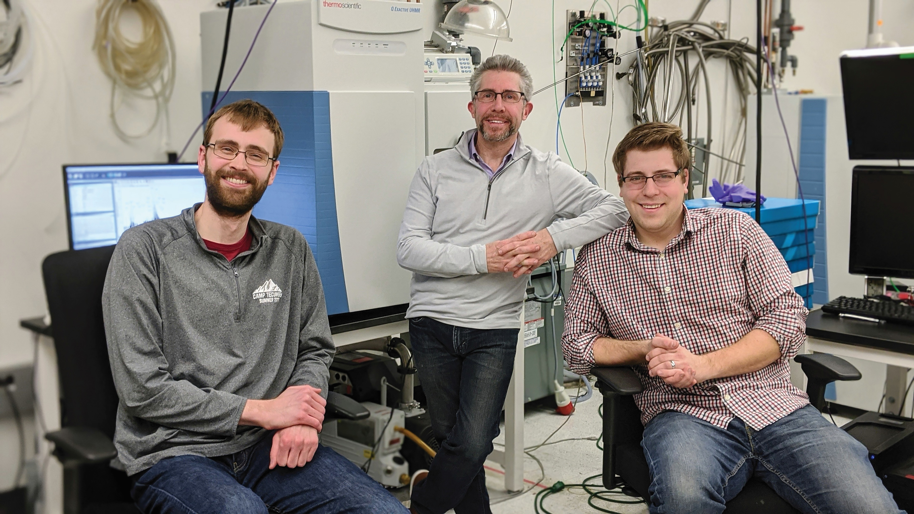
NEIL’S TOP TIPS
01 Don’t follow directly in the footsteps of others. Forging your own path is harder, takes a while – but positions you well in life.
02 Do find good role models and learn how to learn from them (#networking).
03 Embrace risk – ambition feeds on it!
Neil can often be found in the lab, working with graduate student, Jack McGee, and staff member, Jared Kafader.

Slide 21
TALKING POINTS
Why do you think fortitude has been an important attribute for Neil to learn in his life?
When was the last time you demonstrated persistence? In what way do you think persistence is linked to self-belief?
How much do you know about internships? Which companies could you approach to find out more?
What do you think ‘embracing risk’ looks like for a researcher like Neil?

Slide 22
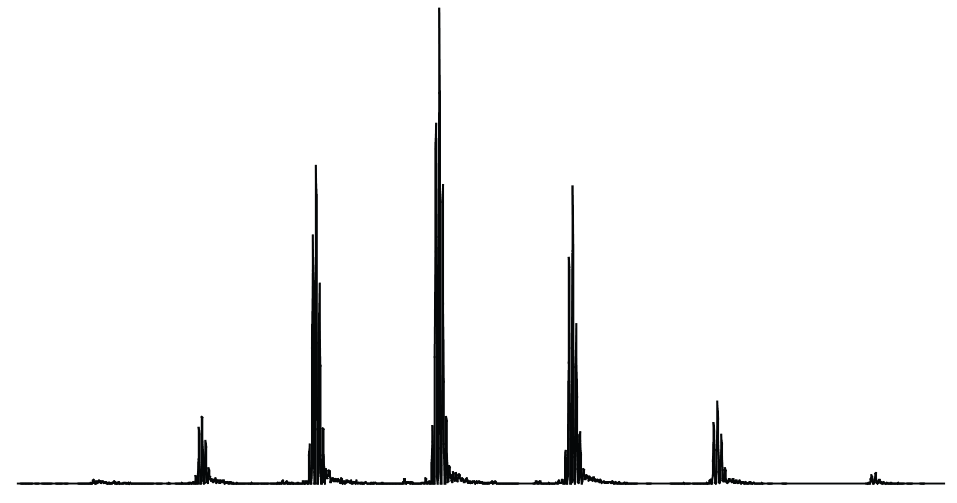
One of Neil’s team, Luis ‘Luifer’ Schachner, is working on a creative project translating proteomic data readouts into a visual representation that mirrors the real world.
With a background in the visual arts, Luifer is taking raw data and presenting them in a creative and fascinating way, with birds, trees and mountain ranges amongst the final images.

Slide 23
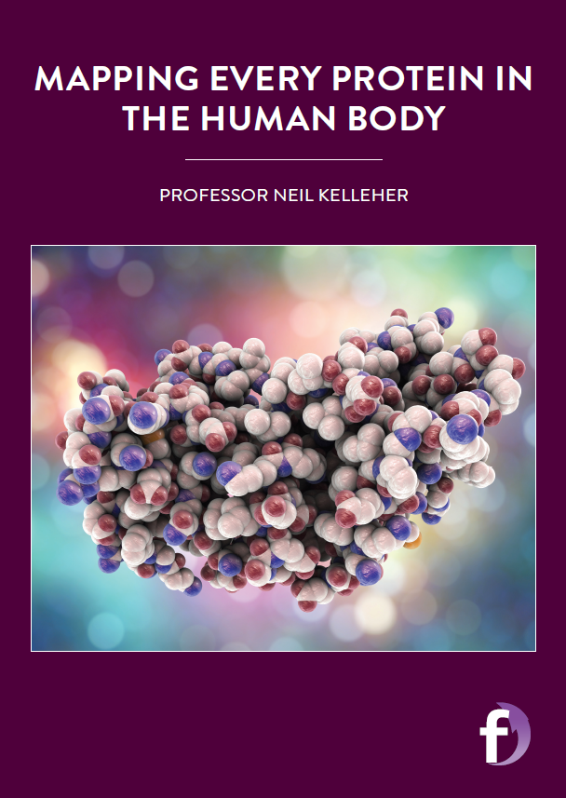
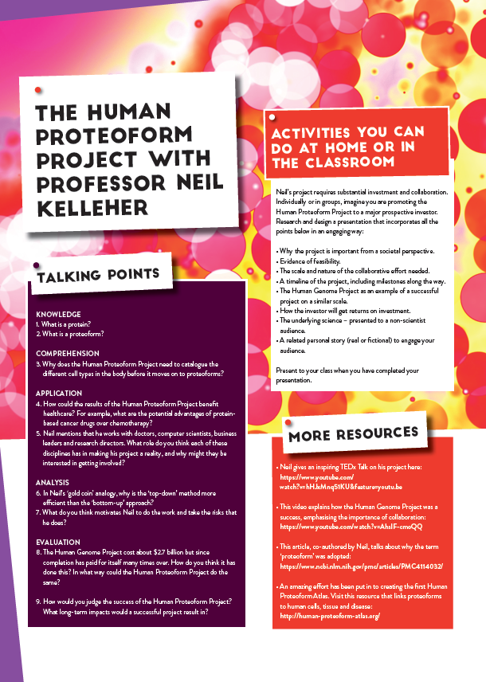
Dig deeper into Neil’s research.
Download his activity sheet.

